Slide 1

Riyadh Philanthropic Society For Science
Prince Sultan College For Woman
Dept. of Computer & Information Sciences
CS 340
Introduction to Database Systems
(Chapter 3 Practice Exercises)

Slide 2
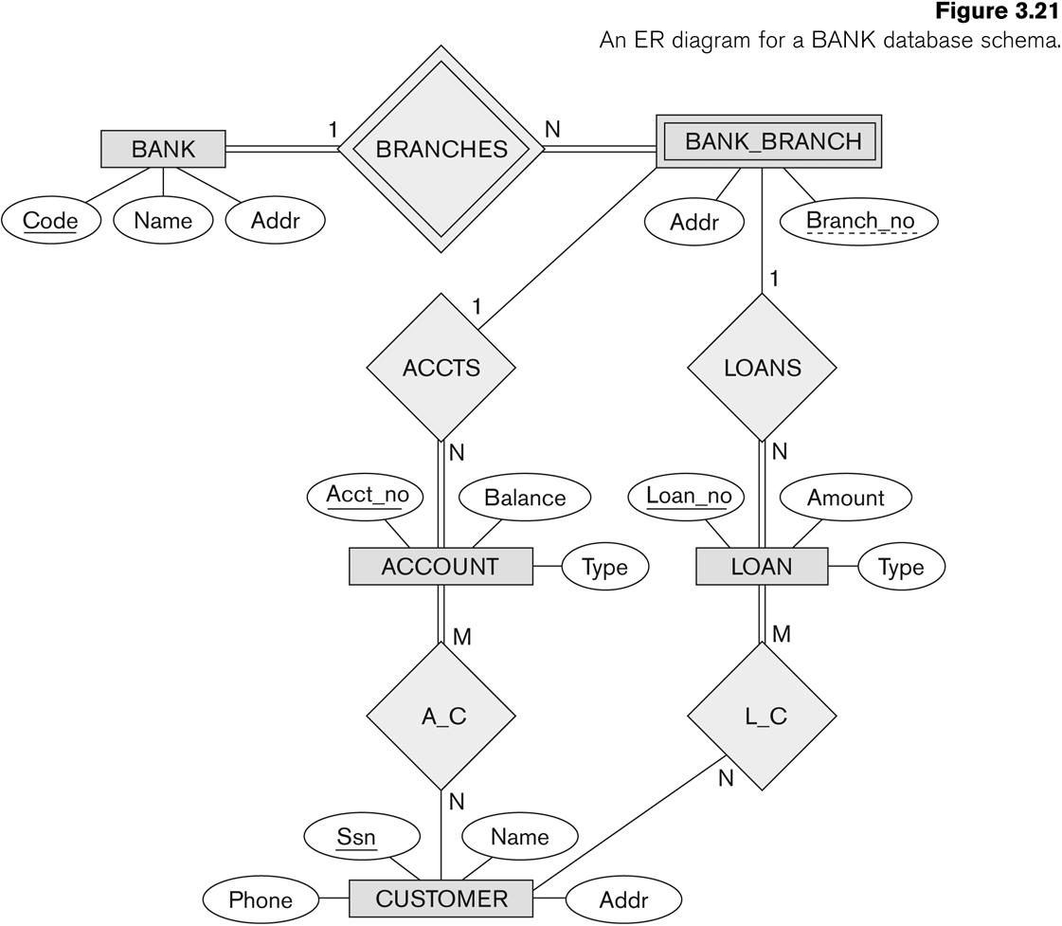
Exercise 3.23
Chapter 3 Practice Exercises
1

Slide 3
Exercise 3.23 (Solution)
a. Non weak entity types: BANK
ACCOUNT
CUSTOMER
LOAN
b. Weak entity type: BANK-BRANCH
Partial key: BranchNo
Identifying relationship: BRANCHES
c. The partial key specifies that the same BranchNo value may
occur under different BANKS.
The identifying relationship specifies that BranchNo values are
uniquely assigned for those BANK-BRANCH entities that are
related to the same BANK entity.
(BANK Code + BranchNo = full identifier for BANK-BRANCH).
Chapter 3 Practice Exercises
2

Slide 4
Exercise 3.23 (Solution)
d. Relationship types and the (min,max) constraints:
BRANCHES
ACCTS
LOANS
A-C
L-C
(1,n)
BRANCHES
(1,1)
BANK
BANK-BRANCH
(0,n)
ACCTS
(1,1)
BANK-BRANCH
ACCOUNT
(0,n)
LOANS
(1,1)
BANK-BRANCH
LOAN
(1,n)
A-C
(0,n)
ACCOUNT
CUSTOMER
(1,n)
L-C
(0,n)
LOAN
CUSTOMER
Chapter 3 Practice Exercises
3

Slide 5
Exercise 3.23 (Solution)
e. User requirements:
  Each bank has a unique code, name, and address.
  Each bank is related to 1 or more bank branches.
  Each bank branch has an address and a branch number which is
  unique among each set of bank branches that are related to the
  same bank.
  Each bank branch has 0 or more loans and 0 or more accounts.
  Each account has an unique account number, balance, and type.
  Each account is related to exactly 1 bank branch and to at least
  1 customer.
  Each loan has a unique loan number, amount, and type.
  Each loan is related to 1 bank branch and to at least 1 customer.
  Each customer has a SSN, name, phone, and address.
  Each customer is related to 0 or more accounts and to 0 or more
  loans.
Chapter 3 Practice Exercises
4

Slide 6
Exercise 3.23 (Solution)
f. The new (min, max) constraints:
(1,n)
A-C
(1,n)
ACCOUNT
CUSTOMER
(1,n)
L-C
(0,2)
LOAN
CUSTOMER
(0,1000)
LOANS
(1,1)
BANK-BRANCH
LOAN
Chapter 3 Practice Exercises
5

Slide 7
Exercise 2
Identify the entities and relationships for the following description
and draw an ER diagram.
Persons, described by their name, SSN, and address, subscribe to various journals. Each journal, identified by a title and an ISBN, has
a set of numbered volumes and each of these has a set of numbered
issues. Subscribers have an initial subscription date and a termination
date for each journal to which they subscribe.
Chapter 3 Practice Exercises
6

Slide 8
Exercise 2 (solution)
SSN
Name
ISBN
M
SUBSCRIBE
-TO
N
PERSON
JORNAL
Title
1
Address
InitialDate
TerminationDate
HAS
N
ISSUE
N
CONTAINED-IN
1
VOLUME
VolumeNo
IssueNo
Chapter 3 Practice Exercises
7

Slide 9
Exercise 3
Identify the entities and relationships for the following description
and draw an ER diagram.
Departments, identified by ID, operate a variety of printers, each
located in a particular room in a particular building. Printers are
supplied by a number of suppliers, identified by name, with each supplier charging a different price for a given printer, but also
providing different delivery delays, measured in days. A given room
can have any number of printers, including none.
Chapter 3 Practice Exercises
8

Slide 10
Exercise 3 (solution)
DId
PrinterId
1
OPERATES
N
DEPARTMENT
PRINTER
N
M
Delay
IN
SUPPLIED
-BY
RoomNo
Charge
1
N
ROOM
SUPPLIER
BuildingNo
SName
Chapter 3 Practice Exercises
9

Slide 11
Exercise 4
Draw an ER diagram for the following situation.
State any assumptions you believe you have to make in order to develop a complete diagram.
Stillwater Antiques buys and sells one-of-a-kind antiques of all kinds (for example, furniture, jewelry, china, and clothing). Each item is uniquely identified by an item number and is also characterized by a description, asking price, condition, and open-ended comments. Stillwater works with many different individuals, called clients, who sell items to and buy items from the store. Some clients only sell items to Stillwater, some only buy items, and some others both sell and buy. A client is identified by a client number and is also described by a client name and client address.
Chapter 3 Practice Exercises
10

Slide 12
Exercise 4
When Stillwater sells an item in stock to a client, the owners want to record the commission paid, the actual selling price, sales tax, and date sold. When Stillwater buys an item from a client, the owners want to record the purchase cost, date purchased, and condition at time of purchase.
Chapter 3 Practice Exercises
11

Slide 13
Exercise 4 (Solution)
SellingPrice
Commission
Tax
DateSold
SoldTo
ItemNumber
Description
ClientNumber
N
1
Price
ITEM
CLIENT
Name
N
1
Condition
Comments
Bought
From
Address
Cost
DateBurchased
Condition
Chapter 3 Practice Exercises
12

Slide 14
Exercise 5
Draw an ER diagram for the following situation.
State any assumptions you believe you have to make in order to develop a complete diagram.
Projects, Inc., is an engineering firm with approximately 500 employees. A database is required to keep track of all employees, projects assigned, and departments worked in. every employee has a unique number assigned by the firm, required to store his or her name and date of birth. If an employee is currently married to another employee of projects, Inc., the date of marriage and who is married to whom must be stored; however, no record of marriage is required if an employee’s spouse is not also an employee. Each employee is given a job title (for example, engineer, secretary, and so on).
Chapter 3 Practice Exercises
13

Slide 15
Exercise 5
An employee does only one type of job at any given time, and it is only needed to retain information for an employee’s current job .
There are 11 different departments, each with a unique name. An employee can report to only one department. Each department has a phone number.
To procure various kinds of equipments, each department deals with many vendors. A vendor typically supplies equipment to many departments. It is required to store the name and address of each vendor and the date of the last meeting between a department and a vendor.
Many employees can work on a project. An employee can work on many projects. Projects are distinguished by project number, and the estimated cost of each project must be stored.
Chapter 3 Practice Exercises
14

Slide 16
Exercise 5 (Solution)
DeptName
LastMeeting
VendorName
M
BuyesFrom
N
Phone
DEPARTMENT
VENDOR
1
Address
belongsTo
DateMarried
N
EmpNumber
ProjName
MarriedTo
1
M
N
EMPLOYEE
WorksOn
PROJECT
1
EmpName
Title
BirthDate
Cost
Chapter 3 Practice Exercises
15

Slide 17
Exercise 6
Consider the following information about a university database:
• Professors have a SSN, a name, an age, a rank, and a research
specialty.
• Projects have a project number, a sponsor name (e.g. NFS), a
starting date, an ending date, and a budget.
• Graduate students have a SSN, a name, an age, and a degree
program (e.g., M.S. or Ph.D.).
• Each project is managed by one professor (known as the project's
principal investigator).
• Each project is worked on by one or more professors (known as the
project's co-investigators).
• Professors can manage and/or work on multiple projects.
Chapter 3 Practice Exercises
16

Slide 18
Exercise 6
• Each project is worked on by one or more graduate students (known
as the project's research assistants).
• When graduate students work on a project, a professor must
supervise their work on the project. Graduate students can work on
multiple projects, in which case they will have a (potentially
different) supervisor for each one.
• Departments have a department number, a department name, and a
main office.
• Departments have a professor (known as the chairman) who runs
the department.
• Professors work in one or more departments, and for each
department that they work in, a time percentage is associated with
their job.
Chapter 3 Practice Exercises
17

Slide 19
Exercise 6
• Graduate students have one major department in which they are
working on their degree.
• Each graduate student has another, more senior graduate student
(known as a student advisor) who advises him or her on what
courses to take.
Draw an ER diagram that captures the information about the university.
Chapter 3 Practice Exercises
18

Slide 20
Exercise 6 (solution)
SSN
PName
Age
Rank
PNo
Sponsor
SDate
EDate
MANAGES
PROFESSOR
1
N
PROJECT
Budget
M
WORKS_ON
N
1
M
M
Specialty
M
1
RUNS
WORKS_IN
SUPERVISES
WORKS
-ON2
N
N
Time
1
N
senior
1
DEPARTMENT
1
MAJOR
N
GRAD_STUDENT
ADVISES
Graduate
N
DNo
DName
Office
SSN
SName
Age
Degree
Chapter 3 Practice Exercises
19

